Slide 1
Project Risk Management
Dr Samad Baseer

Slide 2

Chapter 11: Project Risk Management
Information Technology Project Management, Sixth Edition

Slide 3
Learning Objectives
Understand what risk is and the importance of good project risk management
Discuss the elements involved in risk management planning and the contents of a risk management plan
List common sources of risks in information technology projects

Slide 4
Learning Objectives (continued)
Describe the process of identifying risks and be able to create a risk register
Discuss the qualitative risk analysis process and explain how to calculate risk factors, create probability/impact matrixes, and apply the Top Ten Risk Item Tracking technique to rank risks

Slide 5
Learning Objectives (continued)
Explain the quantitative risk analysis process and how to apply decision trees, simulation, and sensitivity analysis to quantify risks
Provide examples of using different risk response planning strategies to address both negative and positive risks
Discuss what is involved in monitoring and controlling risks
Describe how software can assist in project risk management

Slide 6
The Importance of Project Risk Management
Project risk management is the art and science of identifying, analyzing, and responding to risk throughout the life of a project and in the best interests of meeting project objectives
Risk management is often ignored in projects, but it can help improve project success by helping select good projects, determining project scope, and developing realistic estimates

Slide 7
Research Shows Need to Improve Project Risk Management
Study by Ibbs and Kwak shows risk has the lowest maturity rating of all knowledge areas
A similar survey was completed with software development companies in Mauritius, South Africa in 2003, and risk management also had the lowest maturity
KLCI study shows the benefits of following good software risk management practices

Slide 8
Table 11-1. Project Management Maturity by Industry Group and Knowledge Area*
KEY: 1 = LOWEST MATURITY RATING 5 = HIGHEST MATURITY RATING
Knowledge Area | Engineering/ Construction | Telecommunications | Information Systems | Hi-Tech Manufacturing
Scope | 3.52 | 3.45 | 3.25 | 3.37
Time | 3.55 | 3.41 | 3.03 | 3.50
Cost | 3.74 | 3.22 | 3.20 | 3.97
Quality | 2.91 | 3.22 | 2.88 | 3.26
Human Resources | 3.18 | 3.20 | 2.93 | 3.18
Communications | 3.53 | 3.53 | 3.21 | 3.48
Risk | 2.93 | 2.87 | 2.75 | 2.76
Procurement | 3.33 | 3.01 | 2.91 | 3.33
*Ibbs, C. William and Young Hoon Kwak. “Assessing Project Management Maturity,”
Project Management Journal (March 2000).

Slide 9
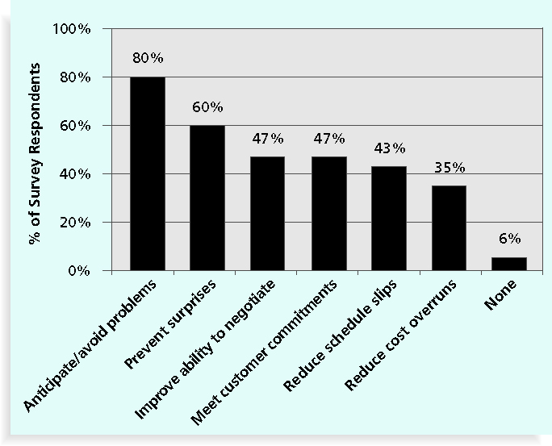
Figure 11-1. Benefits from Software Risk Management Practices*
*Kulik, Peter and Catherine Weber, “Software Risk Management Practices – 2001,” KLCI Research Group (August 2001).

Slide 10
Media Snapshot
Many people around the world suffered from financial losses as various financial markets dropped in the fall of 2008, even after the $700 billion bailout (rescue ) bill was passed by the U.S. Congress
According to a global survey of 316 financial services executives, more than 70 percent of respondents believed that the losses stemming from the credit crisis were largely due to failures to address risk management issues
They identified several challenges in implementing risk management, including data and company culture issues

Slide 11
Negative Risk
A dictionary definition of risk is “the possibility of loss or injury”
Negative risk involves understanding potential problems that might occur in the project and how they might impede (delay, stop) project success
Negative risk management is like a form of insurance; it is an investment

Slide 12
Risk Can Be Positive
Positive risks are risks that result in good things happening; sometimes called opportunities
A general definition of project risk is an uncertainty that can have a negative or positive effect on meeting project objectives
The goal of project risk management is to minimize potential negative risks while maximizing potential positive risks

Slide 13
Best Practice
Some organizations make the mistake of only addressing tactical and negative risks when performing project risk management
David Hillson (www.risk-doctor.com) suggests overcoming this problem by widening the scope of risk management to encompass both strategic risks and upside opportunities, which he refers to as integrated risk management

Slide 14
Risk Utility
Risk utility or risk tolerance is the amount of satisfaction or pleasure received from a potential payoff (payment)
Utility rises at a decreasing rate for people who are risk-averse
Those who are risk-seeking have a higher tolerance for risk, and their satisfaction increases when more payoff is at stake
The risk-neutral approach achieves a balance between risk and payoff

Slide 15
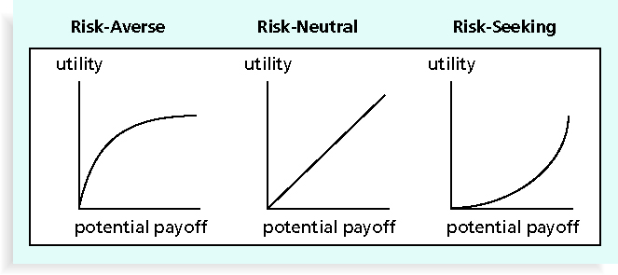
Figure 11-2. Risk Utility Function and Risk Preference

Slide 16
Project Risk Management Processes
Planning risk management: deciding how to approach and plan the risk management activities for the project
Identifying risks: determining which risks are likely to affect a project and documenting the characteristics of each
Performing qualitative risk analysis: prioritizing risks based on their probability and impact of occurrence

Slide 17
Project Risk Management Processes (continued)
Performing quantitative risk analysis: numerically estimating the effects of risks on project objectives
Planning risk responses: taking steps to enhance opportunities and reduce threats to meeting project objectives
Monitoring and controlling risks: monitoring identified risks, identifying new risks, carrying out risk response plans, and evaluating the effectiveness of risk strategies throughout the life of the project

Slide 18
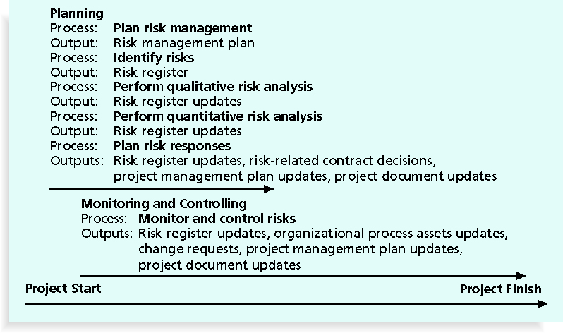
Figure 11-3. Project Risk Management Summary

Slide 19
Risk Management Planning
The main output of risk management planning is a risk management plan, a plan that documents the procedures for managing risk throughout a project
The project team should review project documents and understand the organization’s and the sponsor’s approaches to risk
The level of detail will vary with the needs of the project

Slide 20
Table 11-2. Topics Addressed in a Risk Management Plan
Methodology
Roles and responsibilities
Budget and schedule
Risk categories
Risk probability and impact
Risk documentation

Slide 21
Contingency and Fallback Plans, Contingency Reserves
Contingency plans are predefined actions that the project team will take if an identified risk event occurs
Fallback plans are developed for risks that have a high impact on meeting project objectives and are put into effect if attempts to reduce the risk are not effective
Contingency reserves or allowances are arrangements held by the project sponsor or organization to reduce the risk of cost or schedule overruns to an acceptable level

Slide 22
Common Sources of Risk in Information Technology Projects
Several studies show that IT projects share some common sources of risk
Broad categories of risk help identify potential risks

Slide 23
Broad Categories of Risk
Market risk
Financial risk
Technology risk
People risk
Structure/process risk

Slide 24
What Went Wrong?
KPMG, a large consulting firm, published a study in 1995 that found that 55 percent of runaway projects—projects that have significant cost or schedule overruns—did no risk management at all, 38 percent did some (but half did not use their risk findings after the project was underway), and 7 percent did not know whether they did risk management or not
The timing of risk management is also an important consideration

Slide 25
Risk Breakdown Structure
A risk breakdown structure is a hierarchy of potential risk categories for a project
Similar to a work breakdown structure but used to identify and categorize risks

Slide 26
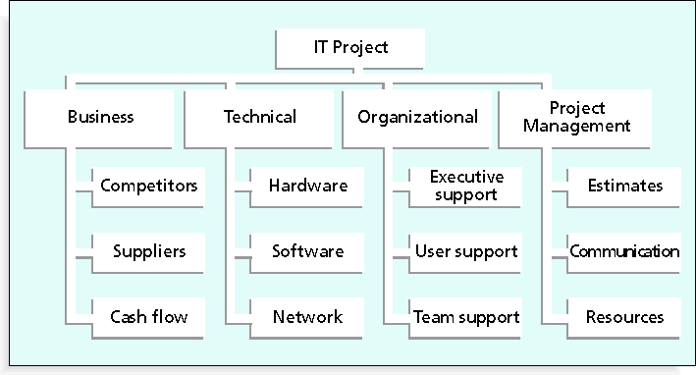
Figure 11-4. Sample Risk Breakdown Structure

Slide 27
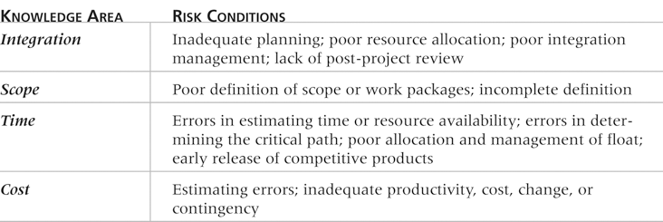
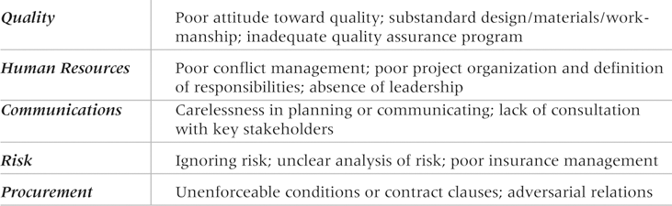
Table 11-4. Potential Negative Risk Conditions Associated with Each Knowledge Area

Slide 28
Identifying Risks
Identifying risks is the process of understanding what potential events might hurt or enhance a particular project
Risk identification tools and techniques include:
Brainstorming
The Delphi Technique
Interviewing
SWOT analysis

Slide 29
Brainstorming
Brainstorming is a technique by which a group attempts to generate ideas or find a solution for a specific problem by gathering ideas spontaneously and without judgment
An experienced facilitator should run the brainstorming session
Be careful not to overuse or misuse brainstorming
Psychology literature shows that individuals produce a greater number of ideas working alone than they do through brainstorming in small, face-to-face groups
Group effects often inhibit idea generation

Slide 30
Delphi Technique
The Delphi Technique is used to derive an agreement among a panel of experts who make predictions about future developments
Provides independent and anonymous input regarding future events
Uses repeated rounds of questioning and written responses and avoids the biasing effects possible in oral methods, such as brainstorming

Slide 31
Interviewing
Interviewing is a fact-finding technique for collecting information in face-to-face, phone, e-mail, or instant-messaging discussions
Interviewing people with similar project experience is an important tool for identifying potential risks

Slide 32
SWOT Analysis
SWOT analysis (strengths, weaknesses, opportunities, and threats) can also be used during risk identification
Helps identify the broad negative and positive risks that apply to a project

Slide 33
Risk Register
The main output of the risk identification process is a list of identified risks and other information needed to begin creating a risk register
A risk register is:
A document that contains the results of various risk management processes and that is often displayed in a table or spreadsheet format
A tool for documenting potential risk events and related information
Risk events refer to specific, uncertain events that may occur to the damage or enhancement of the project

Slide 34
Risk Register Contents
An identification number for each risk event
A rank for each risk event
The name of each risk event
A description of each risk event
The category under which each risk event falls
The root cause of each risk

Slide 35
Risk Register Contents (continued)
Triggers for each risk; triggers are indicators or symptoms of actual risk events
Potential responses to each risk
The risk owner or person who will own or take responsibility for each risk
The probability and impact of each risk occurring
The status of each risk

